Slide 1

Chapter 16 Developing Efficient Algorithms

Slide 2
Objectives
To estimate algorithm efficiency using the Big O notation (§16.2).
To explain growth rates and why constants and nondominating terms can be ignored in the estimation (§16.2).
To determine the complexity of various types of algorithms (§16.3).
To analyze the binary search algorithm (§16.4.1).
To analyze the selection sort algorithm (§16.4.2).
To analyze the insertion sort algorithm (§16.4.3).
To analyze the Towers of Hanoi algorithm (§16.4.4).
To describe common growth functions (constant, logarithmic, log-linear, quadratic, cubic, exponential) (§16.4.5).
To design efficient algorithms for finding Fibonacci numbers (§16.5).
To design efficient algorithms for finding gcd (§16.6).
To design efficient algorithms for finding prime numbers (§16.7).
To design efficient algorithms for finding a closest pair of points (§16.8).
To solve the Eight Queens problem using the backtracking approach (§16.9).
To design efficient algorithms for finding a convex hull for a set of points (§16.10).

Slide 3
Executing Time
Suppose two algorithms perform the same task such as search (linear search vs. binary search) and sorting (selection sort vs. insertion sort). Which one is better? One possible approach to answer this question is to implement these algorithms in Java and run the programs to get execution time. But there are two problems for this approach:
First, there are many tasks running concurrently on a computer. The execution time of a particular program is dependent on the system load.
Second, the execution time is dependent on specific input. Consider linear search and binary search for example. If an element to be searched happens to be the first in the list, linear search will find the element quicker than binary search.

Slide 4
Growth Rate
It is very difficult to compare algorithms by measuring their execution time. To overcome these problems, a theoretical approach was developed to analyze algorithms independent of computers and specific input. This approach approximates the effect of a change on the size of the input. In this way, you can see how fast an algorithm’s execution time increases as the input size increases, so you can compare two algorithms by examining their growth rates.

Slide 5
Big O Notation
Consider linear search. The linear search algorithm compares the key with the elements in the array sequentially until the key is found or the array is exhausted. If the key is not in the array, it requires n comparisons for an array of size n. If the key is in the array, it requires n/2 comparisons on average. The algorithm’s execution time is proportional to the size of the array. If you double the size of the array, you will expect the number of comparisons to double. The algorithm grows at a linear rate. The growth rate has an order of magnitude of n. Computer scientists use the Big O notation to abbreviate for “order of magnitude.” Using this notation, the complexity of the linear search algorithm is O(n), pronounced as “order of n.”

Slide 6
Best, Worst, and Average Cases
For the same input size, an algorithm’s execution time may vary, depending on the input. An input that results in the shortest execution time is called the best-case input and an input that results in the longest execution time is called the worst-case input. Best-case and worst-case are not representative, but worst-case analysis is very useful. You can show that the algorithm will never be slower than the worst-case. An average-case analysis attempts to determine the average amount of time among all possible input of the same size. Average-case analysis is ideal, but difficult to perform, because it is hard to determine the relative probabilities and distributions of various input instances for many problems. Worst-case analysis is easier to obtain and is thus common. So, the analysis is generally conducted for the worst-case.

Slide 7
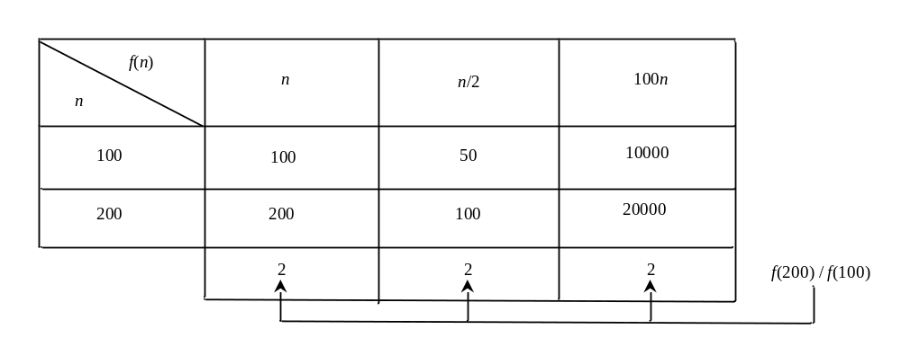
Ignoring Multiplicative Constants
The linear search algorithm requires n comparisons in the worst-case and n/2 comparisons in the average-case. Using the Big O notation, both cases require O(n) time. The multiplicative constant (1/2) can be omitted. Algorithm analysis is focused on growth rate. The multiplicative constants have no impact on growth rates. The growth rate for n/2 or 100n is the same as n, i.e., O(n) = O(n/2) = O(100n).

Slide 8
Ignoring Non-Dominating Terms
Consider the algorithm for finding the maximum number in an array of n elements. If n is 2, it takes one comparison to find the maximum number. If n is 3, it takes two comparisons to find the maximum number. In general, it takes n-1 times of comparisons to find maximum number in a list of n elements. Algorithm analysis is for large input size. If the input size is small, there is no significance to estimate an algorithm’s efficiency. As n grows larger, the n part in the expression n-1 dominates the complexity. The Big O notation allows you to ignore the non-dominating part (e.g., -1 in the expression n-1) and highlight the important part (e.g., n in the expression n-1). So, the complexity of this algorithm is O(n).

Slide 9
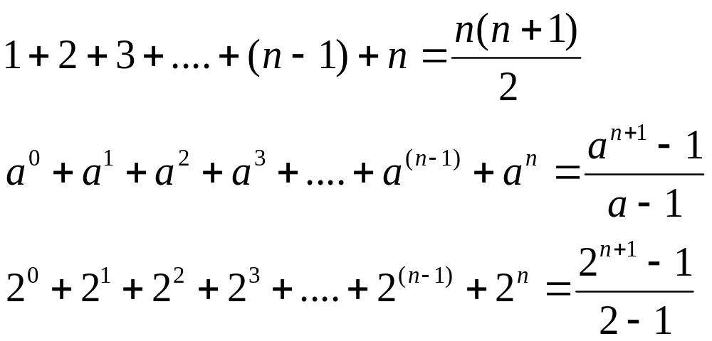
Useful Mathematic Summations

Slide 10
Examples: Determining Big-O
Repetition
Sequence
Selection
Logarithm

Slide 11
Repetition: Simple Loops
for i in range(n):
k = k + 5
executed
n times
constant time
Time Complexity
T(n) = (a constant c) * n = cn = O(n)
Ignore multiplicative constants (e.g., “c”).

Slide 12
Repetition: Nested Loops
for i in range(n):
for j in range(n):
k = k + i + j
executed
n times
inner loop
executed
n times
constant time
Time Complexity
T(n) = (a constant c) * n * n = cn² = O(n²)
Ignore multiplicative constants (e.g., “c”).

Slide 13
Repetition: Nested Loops
for i in range(n):
for i in range(i):
k = k + i + j
executed
n times
inner loop
executed
i times
Time Complexity
constant time
T(n) = c + 2c + 3c + 4c + … + nc = cn(n+1)/2 = (c/2)n² + (c/2)n = O(n²)
Ignore non-dominating terms
Ignore multiplicative constants

Slide 14
Repetition: Nested Loops
for i in range(n):
for i in range(20):
k = k + i + j
executed
n times
inner loop
executed
20 times
Time Complexity
constant time
T(n) = 20 * c * n = O(n)
Ignore multiplicative constants (e.g., 20*c)

Slide 15
Sequence
for i in range(9):
k = k + 4
executed
10 times
for i in range(n):
for i in range(20):
k = k + i + j
executed
n times
inner loop
executed
20 times
Time Complexity
T(n) = c *10 + 20 * c * n = O(n)

Slide 16
Selection
O(n)
if (list.contains(e)) {
System.out.println(e);
}
else
for (Object t: list) {
System.out.println(t);
}
Let n be
list.size().
Executed
n times.
Time Complexity
T(n) = test time + worst-case (if, else)
= O(n) + O(n)
= O(n)

Slide 17
Constant Time
The Big O notation estimates the execution time of an algorithm in relation to the input size. If the time is not related to the input size, the algorithm is said to take constant time with the notation O(1). For example, a method that retrieves an element at a given index in an array takes constant time, because it does not grow as the size of the array increases.

Slide 18
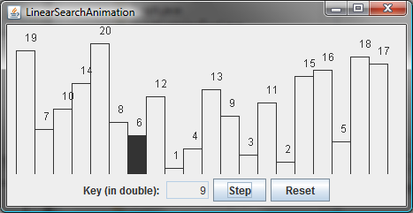

Linear Search Animation
animation
http://www.cs.armstrong.edu/liang/animation/LinearSearchAnimation.html

Slide 19
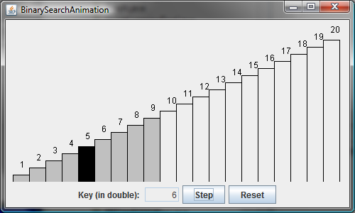
Binary Search Animation
animation
http://www.cs.armstrong.edu/liang/animation/BinarySearchAnimation.html

Slide 20


Logarithm: Analyzing Binary Search
The binary search algorithm presented in Listing 10.10, BinarySearch.java, searches a key in a sorted array. Each iteration in the algorithm contains a fixed number of operations, denoted by c. Let T(n) denote the time complexity for a binary search on a list of n elements. Without loss of generality, assume n is a power of 2 and k=logn. Since binary search eliminates half of the input after two comparisons,

Slide 21
Logarithmic Time
Ignoring constants and smaller terms, the complexity of the binary search algorithm is O(logn). An algorithm with the O(logn) time complexity is called a logarithmic algorithm. The base of the log is 2, but the base does not affect a logarithmic growth rate, so it can be omitted. The logarithmic algorithm grows slowly as the problem size increases. If you square the input size, you only double the time for the algorithm.

Slide 22
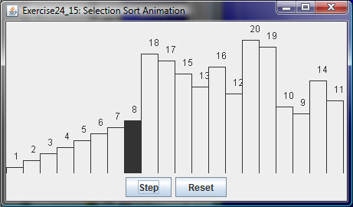
Selection Sort Animation
animation
http://www.cs.armstrong.edu/liang/animation/SelectionSortAnimation.html

Slide 23
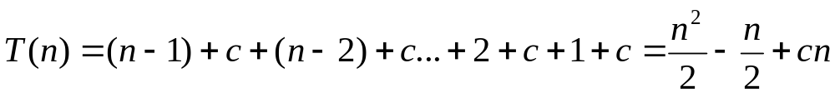
Analyzing Selection Sort
The selection sort algorithm presented in Listing 10.11, SelectionSort.java, finds the largest number in the list and places it last. It then finds the largest number remaining and places it next to last, and so on until the list contains only a single number. The number of comparisons is n-1 for the first iteration, n-2 for the second iteration, and so on. Let T(n) denote the complexity for selection sort and c denote the total number of other operations such as assignments and additional comparisons in each iteration. So,
Ignoring constants and smaller terms, the complexity of the selection sort algorithm is O(n²).

Slide 24
Quadratic Time
An algorithm with the O(n²) time complexity is called a quadratic algorithm. The quadratic algorithm grows quickly as the problem size increases. If you double the input size, the time for the algorithm is quadrupled. Algorithms with a nested loop are often quadratic.

Slide 25
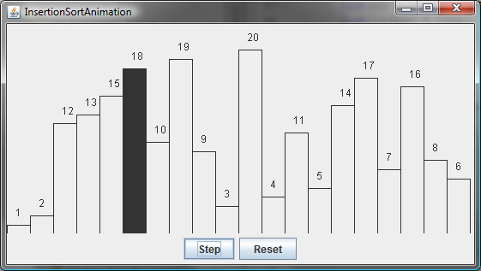
Insertion Sort Animation
animation
http://www.cs.armstrong.edu/liang/animation/InsertionSortAnimation.html

Slide 26
Analyzing Insertion Sort
The insertion sort algorithm presented in Listing 10.12, InsertionSort.java, sorts a list of values by repeatedly inserting a new element into a sorted partial array until the whole array is sorted. At the kth iteration, to insert an element to a array of size k, it may take k comparisons to find the insertion position, and k moves to insert the element. Let T(n) denote the complexity for insertion sort and c denote the total number of other operations such as assignments and additional comparisons in each iteration. So,
Ignoring constants and smaller terms, the complexity of the insertion sort algorithm is O(n²).

Slide 27
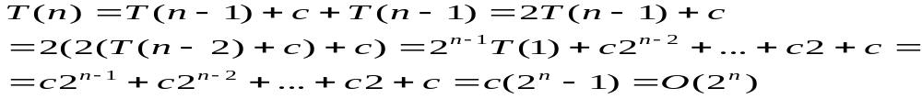
Analyzing Towers of Hanoi
The Towers of Hanoi problem presented in Listing 15.7, TowersOfHanoi.java, moves n disks from tower A to tower B with the assistance of tower C recursively as follows:
  Move the first n – 1 disks from A to C with the assistance of tower B.
  Move disk n from A to B.
  Move n - 1 disks from C to B with the assistance of tower A.
Let T(n) denote the complexity for the algorithm that moves disks and c denote the constant time to move one disk, i.e., T(1) is c. So,

Slide 28
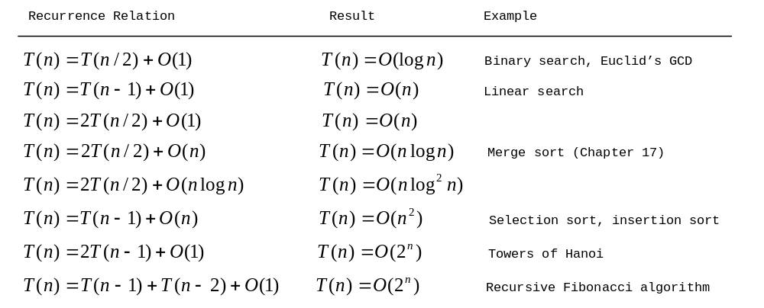
Common Recurrence Relations

Slide 29







Comparing Common Growth Functions
Constant time
Logarithmic time
Linear time
Log-linear time
Quadratic time
Cubic time
Exponential time

Slide 30
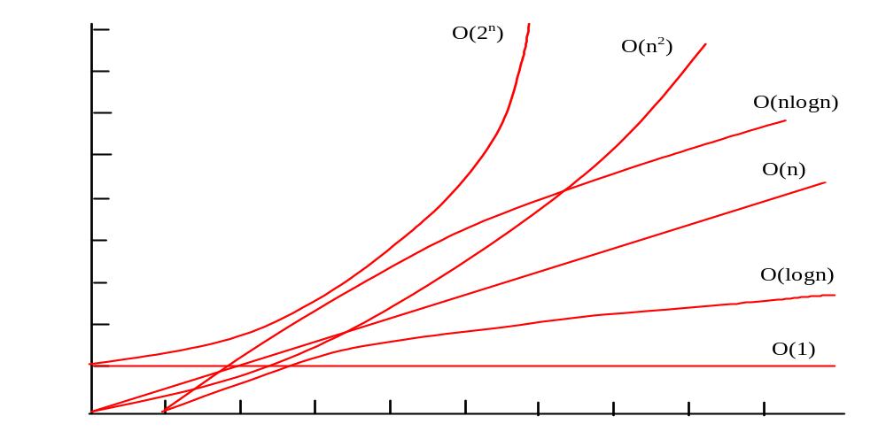
Comparing Common Growth Functions

Slide 31
Case Study: Fibonacci Numbers
/** The method for finding the Fibonacci number */
public static long fib(long index) {
if (index == 0) // Base case
return 0;
else if (index == 1) // Base case
return 1;
else // Reduction and recursive calls
return fib(index - 1) + fib(index - 2);
}
Finonacci series: 0 1 1 2 3 5 8 13 21 34 55 89…
indices: 0 1 2 3 4 5 6 7 8 9 10 11
fib(0) = 0;
fib(1) = 1;
fib(index) = fib(index -1) + fib(index -2); index >=2

Slide 32
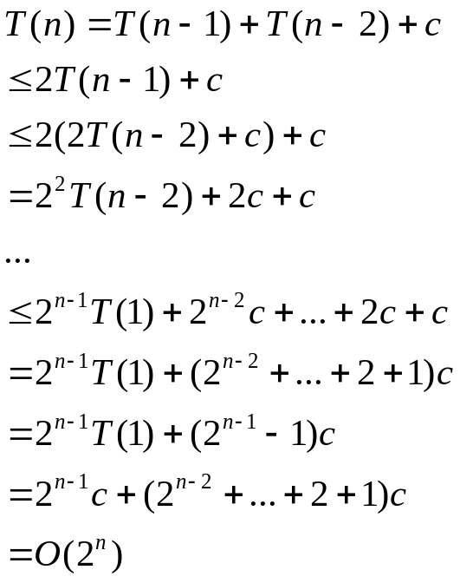
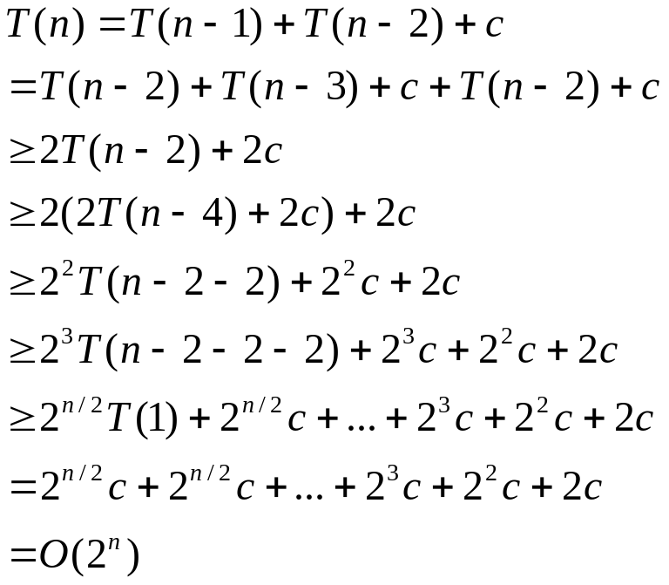

Complexity for Recursive Fibonacci Numbers
Since
and
Therefore, the recursive Fibonacci method takes
.

Slide 33

Case Study: Non-recursive version of Fibonacci Numbers
def fib(n):
f0 = 0 # For fib(0)
f1 = 1 # For fib(1)
f2 = 1 # For fib(2)
if n == 0:
return f0
elif n == 1:
return f1
elif n == 2:
return f2
for i in range(3, n + 1):
f0 = f1
f1 = f2
f2 = f0 + f1
return f2
Obviously, the complexity of this new algorithm is . This is a tremendous improvement over the recursive algorithm.
Improved Fibonacci

Slide 34
f0 f1 f2
Fibonacci series: 0 1 1 2 3 5 8 13 21 34 55 89…
indices: 0 1 2 3 4 5 6 7 8 9 10 11
f0 f1 f2
Fibonacci series: 0 1 1 2 3 5 8 13 21 34 55 89…
indices: 0 1 2 3 4 5 6 7 8 9 10 11
f0 f1 f2
Fibonacci series: 0 1 1 2 3 5 8 13 21 34 55 89…
indices: 0 1 2 3 4 5 6 7 8 9 10 11
f0 f1 f2
Fibonacci series: 0 1 1 2 3 5 8 13 21 34 55 89…
indices: 0 1 2 3 4 5 6 7 8 9 10 11

Slide 35
Dynamic Programming
The algorithm for computing Fibonacci numbers presented here uses an approach known as dynamic programming. Dynamic programming is to solve subproblems, then combine the solutions of subproblems to obtain an overall solution. This naturally leads to a recursive solution. However, it would be inefficient to use recursion, because the subproblems overlap. The key idea behind dynamic programming is to solve each subprogram only once and storing the results for subproblems for later use to avoid redundant computing of the subproblems.

Slide 36
Case Study: GCD Algorithms Version 1
def gcd(m, n):
gcd = 1
k = 2
while k <= m and k <= n:
if m % k == 0 and n % k == 0:
gcd = k
k += 1
return gcd
Obviously, the complexity of this algorithm is .

Slide 37
Case Study: GCD Algorithms Version 2
for k in range(n, 0, -1):
if m % k == 0 and n % k == 0:
gcd = k
break
The worst-case time complexity of this algorithm is still .

Slide 38
Case Study: GCD Algorithms Version 3
for k in range(int(m / 2), 0, -1):
if m % k == 0 and n % k == 0:
gcd = k
break
The worst-case time complexity of this algorithm is still .

Slide 39
Euclid’s algorithm
Let gcd(m, n) denote the gcd for integers m and n:
If m % n is 0, gcd (m, n) is n.
Otherwise, gcd(m, n) is gcd(n, m % n).
m = n*k + r
if p is divisible by both m and n, it must be divisible by r
m / p = n*k/p + r/p

Slide 40
Euclid’s Algorithm Implementation
def gcd(m, n):
if m % n == 0:
return n
else:
return gcd(n, m % n)
The time complexity of this algorithm is O(logn).
See the text for the proof.

Slide 41
Finding Prime Numbers
Compare three versions:
PrimeNumber
Brute-force
Check possible divisors up to Math.sqrt(n)
Check possible prime divisors up to Math.sqrt(n)
PrimeNumbers
EfficientPrimeNumbers
SieveOfEratosthenes

Slide 42
Divide-and-Conquer
The divide-and-conquer approach divides the problem into subproblems, solves the subproblems, then combines the solutions of subproblems to obtain the solution for the entire problem. Unlike the dynamic programming approach, the subproblems in the divide-and-conquer approach don’t overlap. A subproblem is like the original problem with a smaller size, so you can apply recursion to solve the problem. In fact, all the recursive problems follow the divide-and-conquer approach.

Slide 43
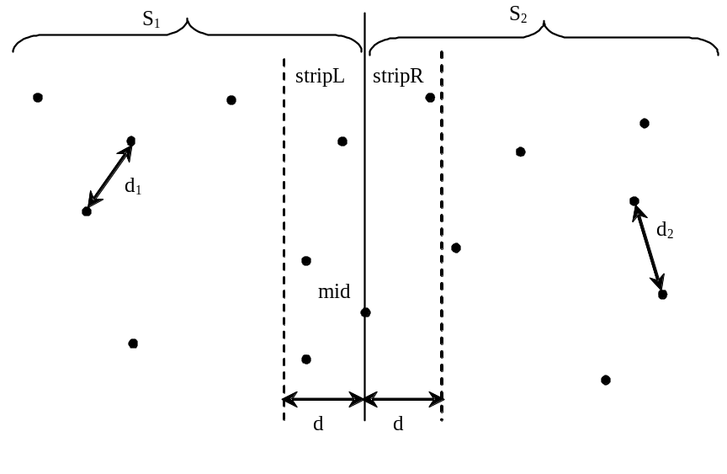
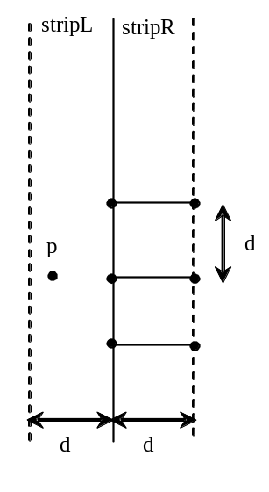
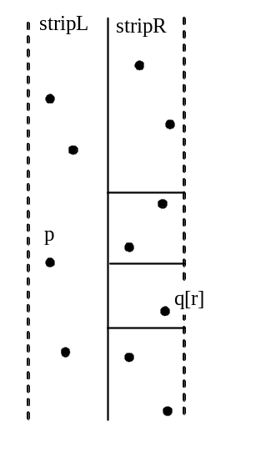
Case Study: Closest Pair of Points

Slide 44
Case Study: Closest Pair of Points

Slide 45
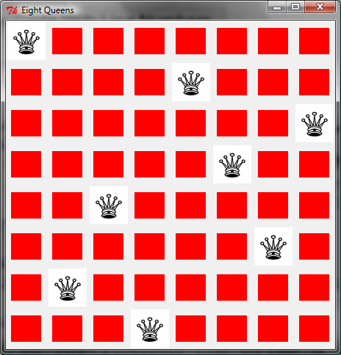
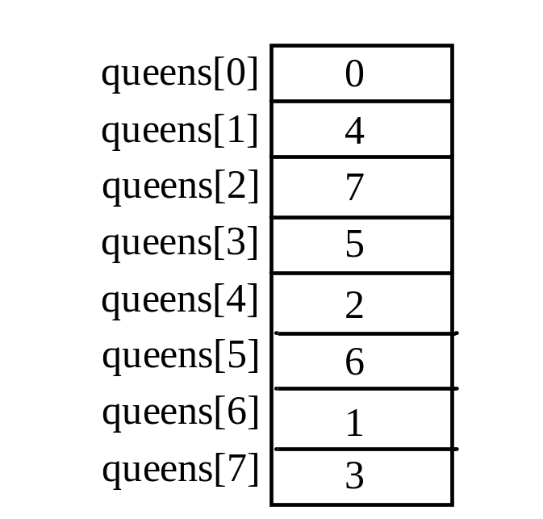
Eight Queens
EightQueens

Slide 46
Backtracking
animation
There are many possible candidates? How do you find a solution? The backtracking approach is to search for a candidate incrementally and abandons it as soon as it determines that the candidate cannot possibly be a valid solution, and explores a new candidate.
http://www.cs.armstrong.edu/liang/animation/EightQueensAnimation.html

Slide 47
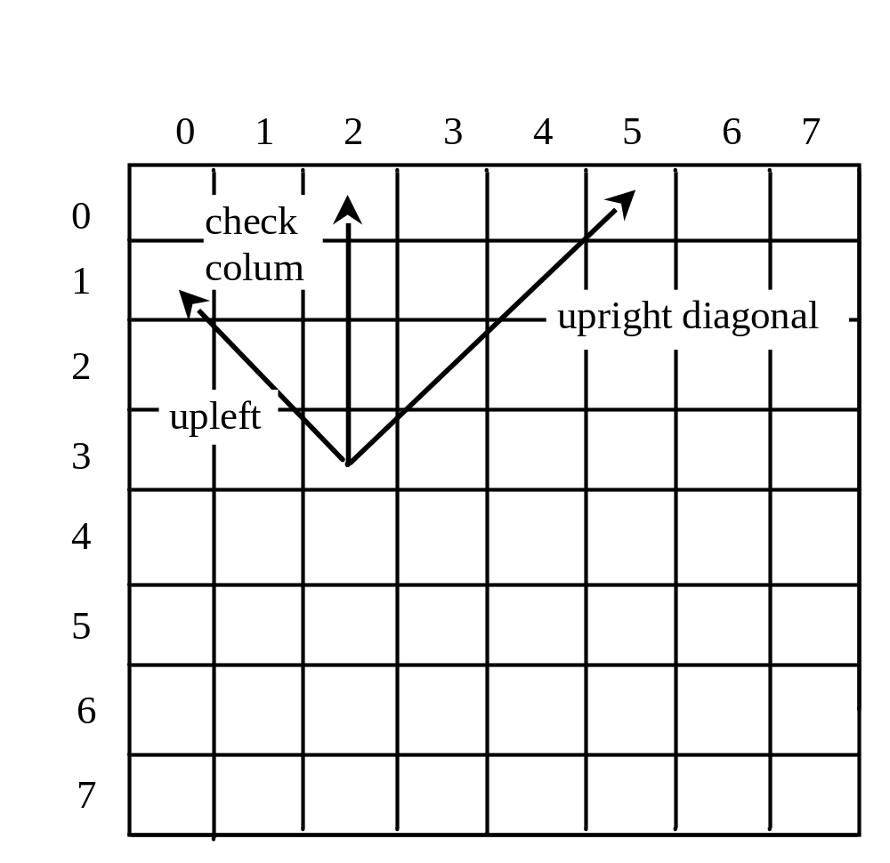
Eight Queens

Slide 48
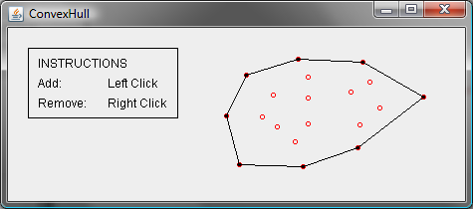
Convex Hull Animation
animation
http://www.cs.armstrong.edu/liang/animation/ConvexHull.html

Slide 49
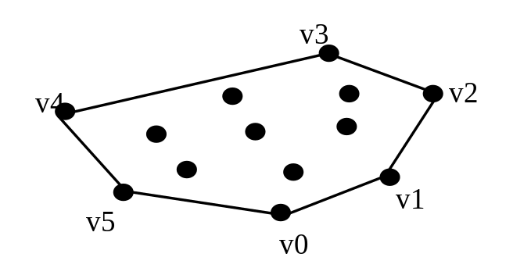
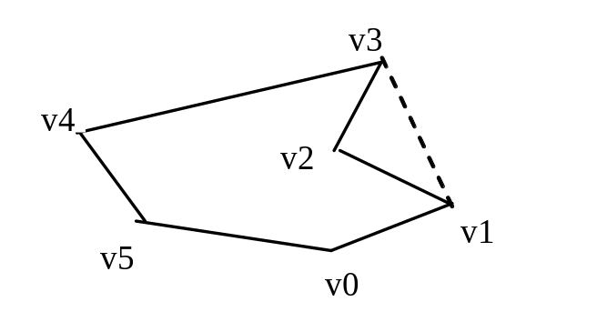
Convex Hull
Given a set of points, a convex hull is a smallest convex polygon that encloses all these points, as shown in Figure a. A polygon is convex if every line connecting two vertices is inside the polygon. For example, the vertices v0, v1, v2, v3, v4, and v5 in Figure a form a convex polygon, but not in Figure b, because the line that connects v3 and v1 is not inside the polygon.
Figure a
Figure b

Slide 50
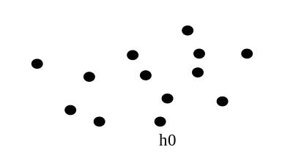
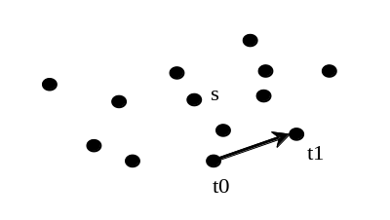
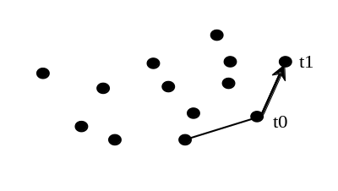
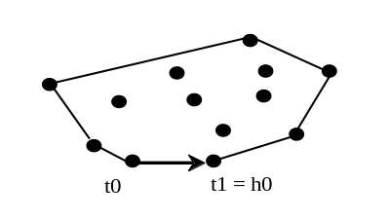
Gift-Wrapping
Step 1: Given a set of points S, let the points in S be labeled s0, s1, ..., sk. Select the rightmost lowest point h0 in the set S. Let t0 be h0.
(Step 2: Find the rightmost point t1): Let t1 be s0. For every point p in S. If p is on the right side of the direct line from t0 to t1 then let t1 be p.
Step 3: If t1 is h0, done.
Step 4: Let t0 be t1, go to Step 2.

Slide 51
Gift-Wrapping Algorithm Time
Finding the rightmost lowest point in Step 1 can be done in O(n) time. Whether a point is on the left side of a line, right side, or on the line can decided in O(1) time (see Exercise 3.32). Thus, it takes O(n) time to find a new point t1 in Step 2. Step 2 is repeated h times, where h is the size of the convex hull. Therefore, the algorithm takes O(hn) time. In the worst case, h is n.

Slide 52

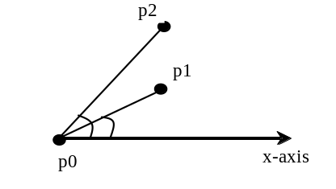
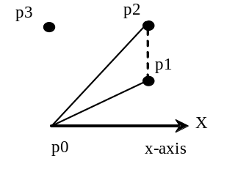
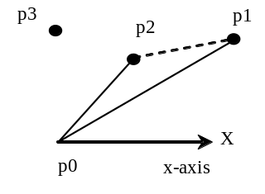
Graham’s Algorithm
Given a set of points S, select the rightmost lowest point and name it p0 in the set S. As shown in Figure 16.7a, p0 is such a point.
Sort the points in S angularly along the x-axis with p0 as the center. If there is a tie and two points have the same angle, discard the one that is closest to p0. The points in S are now sorted as p0, p1, p2, ..., pn-1.
The convex hull is discovered incrementally. Initially, p0, p1, and p2 form a convex hull. Consider p3. p3 is outside of the current convex hull since points are sorted in increasing order of their angles. If p3 is strictly on the left side of the line from p1 to p2, push p3 into H. Now p0, p1, p2, and p3 form a convex hull. If p3 is on the right side of the line from p1 to p2 (see Figure 9.7d), pop p2 out of H and push p3 into H. Now p0, p1, and p3 form a convex hull and p2 is inside of this convex hull.

Slide 53
Graham’s Algorithm Time
O(nlogn)

Slide 54
Practical Considerations
The big O notation provides a good theoretical estimate of algorithm efficiency. However, two algorithms of the same time complexity are not necessarily equally efficient. As shown in the preceding example, both algorithms in Listings 5.6 and 16.2 have the same complexity, but the one in Listing 16.2 is obviously better practically.

